Slide 1

Chapter 8: Typed Arithmetic Expressions
Types
The Typing Relation
Safety = Progress + Preservation

Slide 2
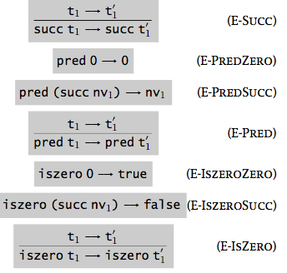
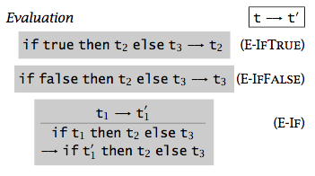

Reall: Syntax and Semantics
^{t ::=}
^{true}
^{false}
^{if t then t else t}
⁰
^{succ t}
^{pred t}
^{iszero t}

Slide 3
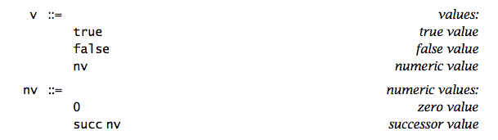

Evaluation Results
Values
Get stuck (i.e., pred false)

Slide 4

Types of Terms
Can we tell, without actually evaluating a term, that the term evaluation will not get stuck?
Distinguish two types of terms:
Nat: terms whose results will be a numeric value
Bool: terms whose results will be a Boolean value
“a term t has type T” means that t “obviously” (statically) evaluates to a value of T
if true then false else true has type Bool
pred (succ (pred (succ 0))) has type Nat

Slide 5
The Typing Relation: t : T

Slide 6
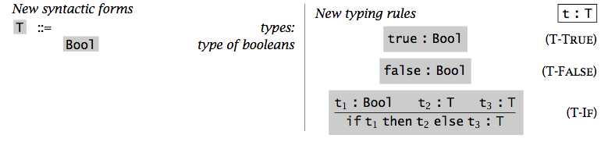

Typing Rule for Booleans

Slide 7
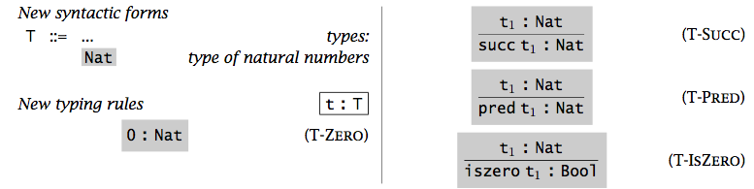

Typing Rules for Numbers

Slide 8

Typing Relation: Formal Definition
Definition: the typing relation for arithmetic expressions is the smallest binary relation between terms and types satisfying all instances of the typing rules.
A term t is typable (or well typed) if there is some T such that t : T.

Slide 9
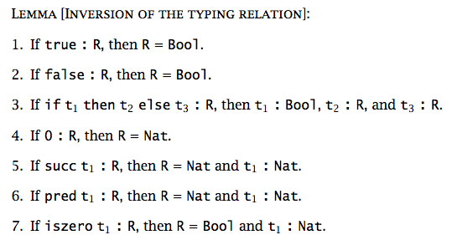

Inversion Lemma (Generation Lemma)
Given a valid typing statement, it shows
how a proof of this statement could have been generated;
a recursive algorithm for calculating the types of terms.

Slide 10
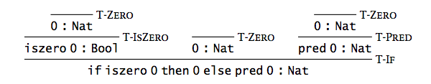

Typing Derivation
Statements are formal assertions about the typing of programs.
Typing rules are implications between statements
Derivations are deductions based on typing rules.

Slide 11
Uniqueness of Types
Theorem [Uniqueness of Types]: Each term t has at most one type. That is, if t is typable, then its type is unique.
Note: later on, we may have a type system where a term may have many types.
Notes:
Prove by induction on t.

Slide 12
Safety = Progress + Preservation

Slide 13
Safety (Soundness)
By safety, it means well-typed terms do not “go wrong”.
By “go wrong”, it means reaching a “stuck state” that is not a final value but where the evaluation rules do not tell what to do next.

Slide 14
Safety = Progress + Preservation
Well-typed terms do not get stuck
Progress: A well-typed term is not stuck (either it is a value or it can take a step according to the evaluation rules).
Preservation: If a well-typed term takes a step of evaluation, then the resulting term is also well typed.

Slide 15

Progress
Theorem [Progress]: Suppose t is a well-typed term (that is, t : T for some T). Then either t is a value or else there is some t′ with t → t′.
Proof: By induction on a derivation of t : T.
- case T-True: true : Bool OK?
- case T-If:
t1 : Bool, t2 : T, t3 : T
--------------------------- OK?
if t1 then t2 else t3 : T
- …
Notes:
Case T-If: t = if t1 then t2 else t3 t1 :Bool t2 :T t3 :T
By the induction hypothesis, either t1 is a value or else there is some t′1 such that t1 􏰄→ t′1. If t1 is a value, then the canonical forms lemma (8.3.1) assures us that it must be either true or false, in which case either E-IfTrue or E-IfFalse applies to t. On the other hand, if t1 􏰄→ t′1, then, by T-If, t 􏰄→ if t′1 then t2 else t3.

Slide 16

Preservation
Theorem [Preservation]:
If t : T and t → t′, then t′ : T.
Proof: By induction on a derivation of t : T.
- case T-True: true : Bool OK?
- case T-If:
t1 : Bool, t2 : T, t3 : T
--------------------------- OK?
if t1 then t2 else t3 : T
- …
Note: The preservation theorem is often called subject reduction property (or subject evaluation property)
Notes:
If the last rule in the derivation is T-True …
If the last rule in the derivation is T-If …
We can prove it by induction on evaluation too.
Unlike uniqueness of types, which holds in some type systems and not in others, progress and preservation will be basic requirements for all of the type systems that we consider.

Slide 17
Homework
Read Chapter 8.
Do Exercises 8.3.7
Notes:
Exercise [Recommended, 􏰁􏰁]: Suppose our evaluation relation is defined in the big-step style, as in Exercise 3.5.17. How should the intuitive property of type safety be formalized?

